Slide 1
CAPSTONE PROJECT
TITANIC DATASET
Presented By:
NAME :AJAY AMIRTHARAJ .A
REG NO :950921105001 YEAR : III
DEPARTMENT :Electrical and Electronics department
COLLEGE :Holy cross Engineering college

Slide 2
Outline :
Introduction
Problem statement
Proposed solution
Algorithm
Result
conclusion
Reference

Slide 3
Introduction :
The Titanic Dataset link is a dataset curated on the basis of the passengers on titanic, like their age, class, gender, etc to predict if they would have survived or not. While there was some element of luck involved in surviving, it seems some groups of people were more likely to survive than others.

Slide 4
Problem statement :
The competition is simple: we want you to use the Titanic passenger data (name, age, price of ticket, etc.) to try to predict who will survive and who will die. The requirement is to predict passengers' survive.

Slide 5
Proposed solution :
Solving the Titanic problem on Kaggle involves using machine learning techniques to predict which passengers survived the Titanic shipwreck. The dataset provides information about the passengers, such as their age, gender, ticket class, and whether they survived.
To solve this problem, you can start by exploring and understanding the dataset, performing data preprocessing, feature engineering, and selecting an appropriate machine learning algorithm to train and test the model. Popular algorithms for this problem include logistic regression, random forests, and gradient boosting.

Slide 6
Algorithm :
Data Collection: Obtain the Titanic dataset, which contains information about passengers such as age, gender, ticket class, fare, cabin, etc.Data Preprocessing:Handle missing values: You may need to fill in missing values or drop rows/columns with too many missing values.Feature engineering: Create new features or transform existing ones that might be useful for prediction (e.g., extracting titles from names, creating a family size feature, etc.).Encode categorical variables: Convert categorical variables into numerical format using techniques like one-hot encoding or label encoding.Split Data: Divide the dataset into training and testing sets to evaluate the performance of the algorithm

Slide 7
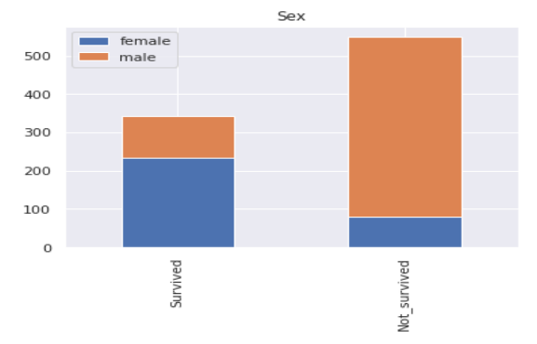
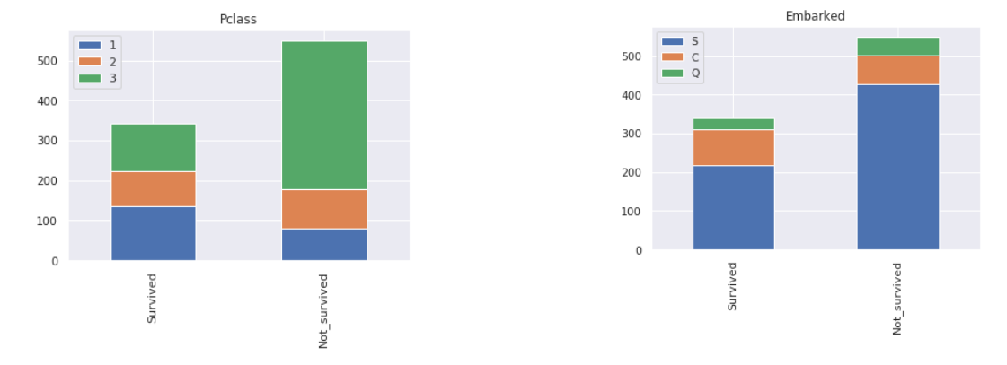
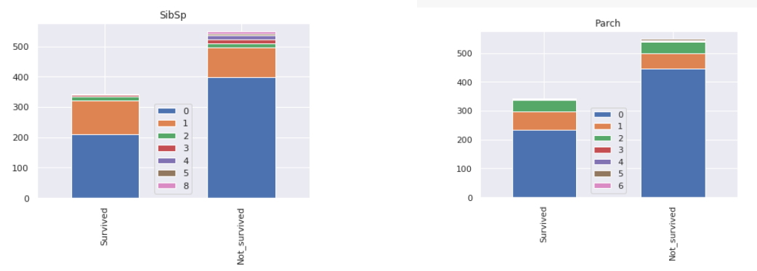
Result :

Slide 8
Conclusion :
The purpose of Titanic dataset is to use the existing features of passengers onboard Titanic as predictors to predict their survival outcome, for 0 being dead and 1 being survived from the tragic ship crash. It is certain through the practice of model improvement, the SVM analysis is better performed than the original logistic regression analysis for prediction accuracy.
However, even from the logistic regression model, we can easily see that the Titanic survival outcome is highly depended on several predictors, such as sex, age and passenger class. In particular, female are more likely to survived than male while keeping other predictors conditions constant, older people are less likely to survived while keeping other predictors conditions constant; and lastly, people from a lower class are less likely to survived keeping other predictors conditions constant.

Slide 9
Reference :
https://www.kaggle.com/c/titanic
https://www.tensorflow.org/datasets/catalog/titanic
https://www.geeksforgeeks.org/titanic-survival-prediction-using-tensorflow-in-python/

Slide 10
THANK YOU

